Slide 1
Comparing Treatments in the Presence of Competing Risks Based on Life Years Lost
Theodore Karrison, PhD
James Dignam, PhD
University of Chicago

Slide 2
Outline
Competing Risks Problem
Estimable Quantities
Inference
Stata Routines for Life Years Lost
Example (DeCIDE)
Simulation Study
Summary

Slide 3
Competing Risks Problem
For time to event data, competing risks refers to situations where one of several mutually exclusive types of failure may occur.
Competing risks frequently arise in analysis of time-to-event outcomes.
For example, in cancer clinical trials, patients may be at increased risk for other chronic disease deaths due to late age at onset or shared risk factors:
Men with early stage (localized) prostate cancer may undergo surgery, radiation, and/or hormonal therapy. However, typically 70% or more of these men will eventually die from some cause other than prostate cancer.
Head-and-neck cancer is another example in which a relatively high proportion of patients will die from non-cancer related causes.

Slide 4


Slide 5



The survivor function and hazard function for T,
$$S\left(t\right)=\operatorname{Pr}\left(T>t\right)and λ\left(t\right)=\lim_{Δt→0}{\frac{Pr⁡(t≤T<t+Δt|T≥t)}{Δt}}$$
2. The cause-specific hazard function for failures due to cause $k$,
$$λ_{k}\left(t\right)=\lim_{Δt→0}{\frac{Pr⁡(t≤T<t+Δt,δ=k|T≥t)}{Δt}}$$
3. Cumulative incidence (probability) of each failure type,
$$F_{k}=\operatorname{Pr}\left(T≤t,δ=k\right)=\int_{0}^{t}{S\left(u\right)λ_{k}\left(u\right)du.}$$

Slide 6
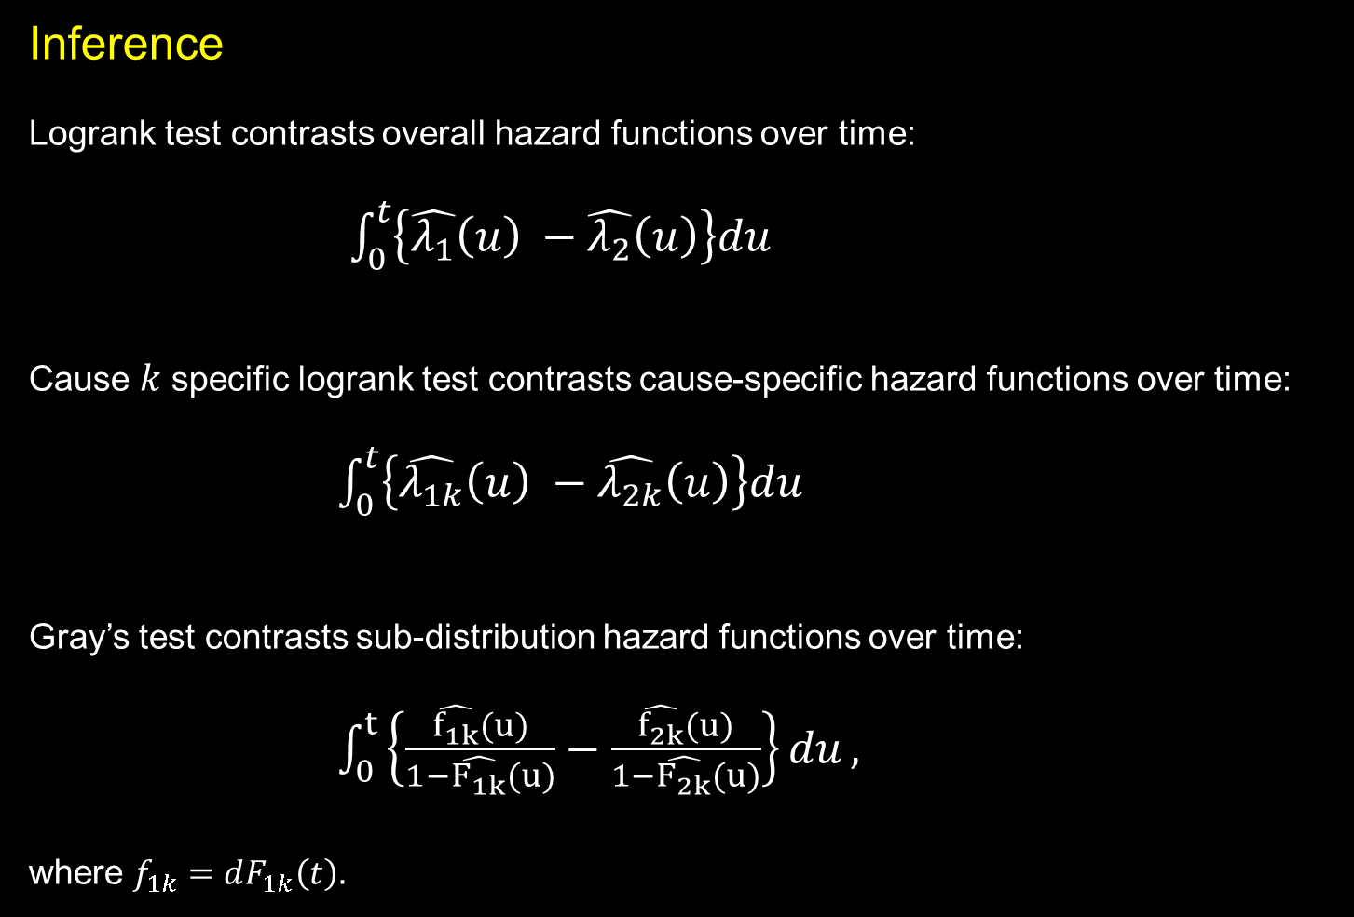
Inference
Logrank test contrasts overall hazard functions over time:
$\int_{0}^{t}{\left\{\hat{λ_{1}}\left(u\right) −\hat{λ_{2}}\left(u\right)\right\}du}$
Cause $k$ specific logrank test contrasts cause-specific hazard functions over time:
$\int_{0}^{t}{\left\{\hat{λ_{1k}}\left(u\right) −\hat{λ_{2k}}\left(u\right)\right\}du}$
Gray’s test contrasts sub-distribution hazard functions over time:
$\int_{0}^{t}{\left\{\frac{\hat{f_{1k}}(u)}{1−\hat{F_{1k}}(u)}−\frac{\hat{f_{2k}}(u)}{1−\hat{F_{2k}}(u)}\right\}du},$
where $f_{1k}=dF_{1k}\left(t\right).$
All three procedures yield a hazard ratio (HR) or sub-distribution hazard ratio (SHR) under a proportionality assumption.

Slide 7

Number of life years lost (LYL) due to cause $k$(Andersen, Stat in Med 2012).
Method is analogous to restricted mean survival time (Karrison, Cont Clin Trials 1997), but takes the area under the cumulative incidence curve rather than the area under the survival curve:
Since $S\left(t\right)=1−\sum_{k}{F_{k}\left(t\right), }$
$L\left(0,τ\right)=τ−\int_{0}^{τ}{S\left(u\right)du=\sum_{k}{\int_{0}^{τ}{F_{k}\left(u\right)du}}}$.
The components
$L_{k}\left(0,τ\right)=\int_{0}^{τ}{F_{k}\left(u\right)du}$
represent the LYL due to cause k up to time $τ$.
No proportional hazards assumption required.

Slide 8
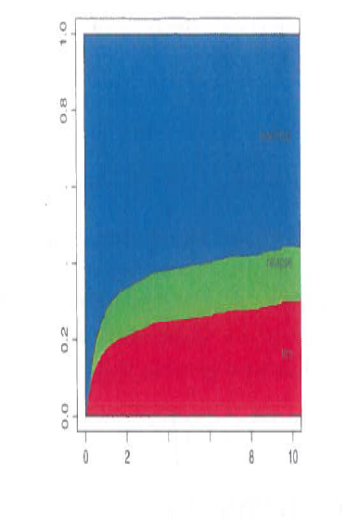

Graphically,
$\hat{L_{k}}\left(0,τ\right)=\int_{0}^{τ}{\hat{F_{k}}\left(u\right)du}$ has an approximate Normal distribution with mean $L_{k}\left(0,τ\right)$ and variance that can be estimated by
$\hat{{ σ}_{}^{2}}=\int_{0}^{τ}{\frac{1}{{(Y\left(t\right)}^{2}}\left[{\left(\int_{t}^{τ}{\hat{S}\left(u\right)du}\right)}^{2}dN_{k}\left(t\right)+{\left(\hat{F_{k}}\left(u\right)du\right)}^{2}dN_{−k}(t)\right]}$,
where ${N\left(t\right) and N}_{k}(t)$ count the number of total failures and cause $k$failures, respectively, in [0,t] and $N_{−k}\left(t\right)=N(t)−N_{k}(t)$.
From Andersen, 2013

Slide 9

Stata Routines for Life Years Lost
Pseudo-observations approach (Overgaard et al, Stata Journal, 2015)
Let $θ=L_{k}\left(0,τ\right)$
$\hat{θ_{i}}=n\hat{θ}−(n−1)\hat{θ_{−i}}$
Once the pseudo-observations have been calculated, they can be used in a generalized linear model together with a sandwich variance estimate.
A Stata routine is available to calculate the pseudo-observations within the user-written pseudo package:
Syntax: stplost [ varname ] [ if ] [ in ], at(numlist) [ generate(name) atnumbers
after(time) competingvalues(numlist) replace ]

Slide 10
Alternatively, one can use a modified version of the user-written stpepemori command.
Pepe and Mori (Stat in Med, 1993) considered integrated weighted differences between two cumulative incidence curves, with a weight function that downweights differences at later time points.
Can calculate YLY (and the difference in YLY between groups) by simply changing the weight function to 1.0:
g `w_1' = cond(_n>1,((`N0'+`N1')*`C0_1'[_n-1]*`C1_1'[_n-1]) / (`N0'*`C0_1'[_n-1] +
> `N1'*`C1_1'[_n-1]),1)
g `w_2' = cond(_n>1,((`N0'+`N1')*`C0_2'[_n-1]*`C1_2'[_n-1]) / (`N0'*`C0_2'[_n-1] +
> `N1'*`C1_2'[_n-1]),1)
➔
g `w_1' = 1.0
g `w_2' = 1.0
(along with some other housekeeping changes and simplifications).
Syntax: stpepemorimod varname [if] [in] , compet(numlist)
Both routines require that the data first be stset.

Slide 11
Example
DeCIDE was a randomized, phase III clinical trial comparing induction therapy plus chemoradiotherapy (I+CRT) vs. chemoradiotherapy alone (CRT) in patients with locally advanced head and neck cancer (Cohen et al, J Clin Oncol 2014)

Slide 12
Competing Risks Analysis
Gray’s test: Gray’s test:
SHR=0.64, 95% CI: 0.36-1.14, p=0.13 SHR=1.46, 95% CI: 0.74-2.89, p=0.27
Cause-specific logrank test: Cause-specific logrank test:
HR=0.66, 95% CI: 0.37-1.19, p=0.17 HR=1.41, 95% CI: 0.71-2.79, p=0.33

Slide 13
Life Years Lost Analysis
Death due to head-and-neck cancer
. stset ostime, failure(csd==1)
failure event: csd == 1
obs. time interval: (0, ostime]
exit on or before: failure
---------------------------------------------------------------------
273 total observations
0 exclusions
---------------------------------------------------------------------
273 observations remaining, representing
47 failures in single-record/single-failure data
. stplost csd, at(72) competingvalues(2)
Pseudo-observations for the lost life time function.
Competing risks: csd = 2.
Computing pseudo-observations (progress dots indicate percent completed).
----+--- 1 ---+--- 2 ---+--- 3 ---+--- 4 ---+--- 5
.................................................. 50
.................................................. 100
Generated variable: pseudo.

Slide 14
. glm pseudo trt, link(id) vce(robust)
-----------------------------------------------------------------------
| Robust
pseudo | Coef. Std. Err. z P>|z| [95% Conf. Interval]
-------------+---------------------------------------------------------
trt | -4.255502 2.594661 -1.64 0.101 -9.340945 .8299412
_cons | 11.9359 2.025931 5.89 0.000 7.965149 15.90665
-----------------------------------------------------------------------
. lincom _cons + trt
( 1) [pseudo]trt + [pseudo]_cons = 0
-----------------------------------------------------------------------
pseudo | Coef. Std. Err. z P>|z| [95% Conf. Interval]
-------------+---------------------------------------------------------
(1) | 7.680398 1.621072 4.74 0.000 4.503156 10.85764
-----------------------------------------------------------------------
Months of life lost:
CRT: 11.9 95% CI: 8.0 – 15.9
I+CRT: 7.7 95% CI: 4.5 – 10.9
Diff: -4.3 95% CI: -9.3 – 0.8, p=0.10

Slide 15
Death due to other causes
. drop pseudo
. stset ostime, failure(csd==2)
failure event: csd == 2
obs. time interval: (0, ostime]
exit on or before: failure
------------------------------------------------------------------------------
273 total observations
0 exclusions
------------------------------------------------------------------------------
. stplost csd, at(72) competingvalues(1)
Pseudo-observations for the lost life time function.
Competing risks: csd = 1.
Computing pseudo-observations (progress dots indicate percent completed).
----+--- 1 ---+--- 2 ---+--- 3 ---+--- 4 ---+--- 5
.................................................. 50
.................................................. 100
Generated variable: pseudo.

Slide 16
. glm pseudo trt, link(id) vce(robust)
------------------------------------------------------------------------------
| Robust
pseudo | Coef. Std. Err. z P>|z| [95% Conf. Interval]
-------------+----------------------------------------------------------------
trt | 3.227143 2.492403 1.29 0.195 -1.657878 8.112163
_cons | 6.052452 1.587142 3.81 0.000 2.941711 9.163193
------------------------------------------------------------------------------
. lincom _cons + trt
( 1) [pseudo]trt + [pseudo]_cons = 0
------------------------------------------------------------------------------
pseudo | Coef. Std. Err. z P>|z| [95% Conf. Interval]
-------------+----------------------------------------------------------------
(1) | 9.279595 1.921732 4.83 0.000 5.513069 13.04612
------------------------------------------------------------------------------
Months of life lost:
CRT: 6.1 95% CI: 2.9 – 9.2
I+CRT: 9.3 95% CI: 5.5 – 13.0
Diff: 3.2 95% CI: -1.7 – 8.1, p=0.20

Slide 17
Pepe-Mori
. stpepemorimod trt, compet(2)
Pepe and Mori test comparing the cumulative incidence of two groups of trt
Main event failure: csd == 1
Integrated cumulative incidence, Group 1: 11.835388
Integrated cumulative incidence, Group 2: 7.6093979
Difference in integrated cumulative incidence: 4.2259908
SE of difference: 2.5873662
Chi2(1) = 2.6677 - p = 0.1024
Competing event failure: csd == 2
Integrated cumulative incidence, Group 1: 6.0153708
Integrated cumulative incidence, Group 2: 9.2418594
Difference in integrated cumulative incidence: 3.2264886
SE of difference: 2.5058621
Chi2(1) = 1.6579 - p = 0.19789
Results are similar to pseudo-observations approach.

Slide 18
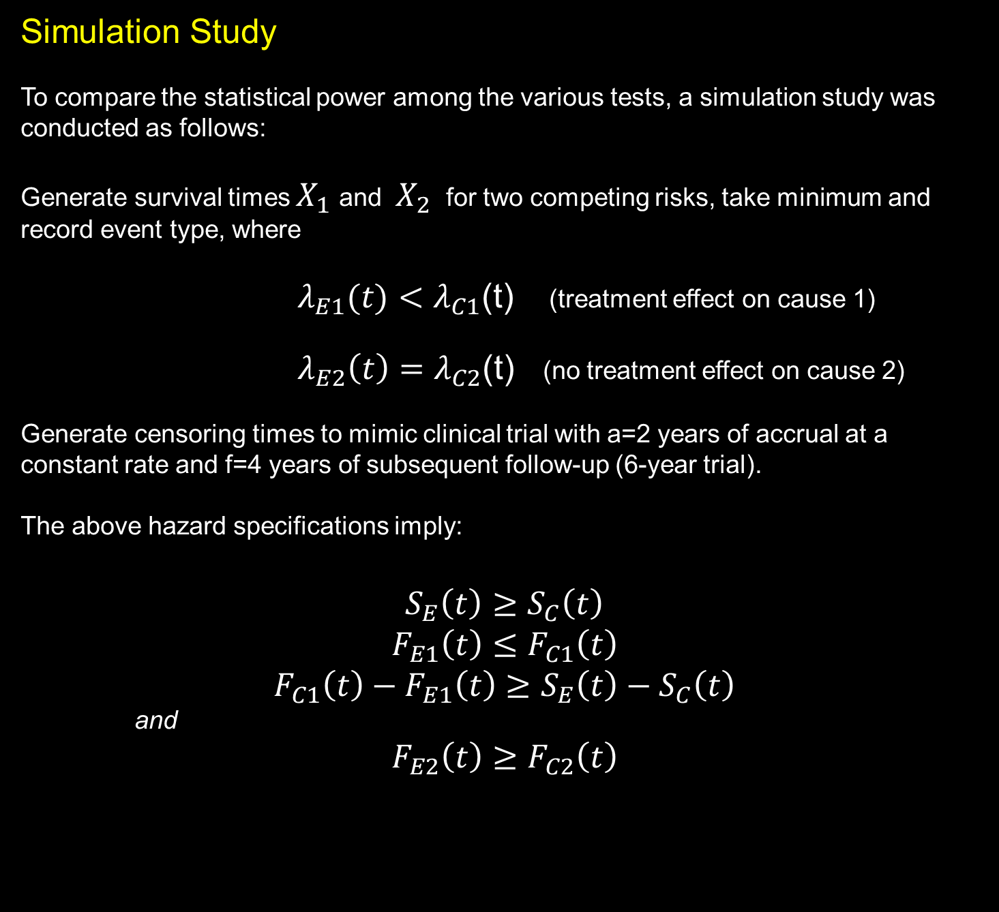
Simulation Study
To compare the statistical power among the various tests, a simulation study was conducted as follows:
Generate survival times $X_{1}$ and $X_{2}$ for two competing risks, take minimum and record event type, where
${ λ}_{E1}(t)<λ_{C1}$(t) (treatment effect on cause 1)
$λ_{E2}\left(t\right)=λ_{C2}$(t) (no treatment effect on cause 2)
Generate censoring times to mimic clinical trial with a=2 years of accrual at a constant rate and f=4 years of subsequent follow-up (6-year trial).
The above hazard specifications imply:
$$S_{E}\left(t\right)≥S_{C}\left(t\right)$$
$$F_{E1}\left(t\right)≤F_{C1}\left(t\right)$$
$$F_{C1}\left(t\right)−F_{E1}\left(t\right)≥S_{E}\left(t\right)−S_{C}\left(t\right)$$
and
$$F_{E2}\left(t\right)≥F_{C2}\left(t\right)$$

Slide 19

Data generated from exponential or Weibull models
Scenarios: Null (type I error check)
Proportional hazards (PH)
Early emerging treatment difference
Late emerging treatment difference
n=100, 125, 150 per group
a=2, f=4 (% censoring ranged from 15% to 35%)
Power compared for the following tests:
Logrank test for overall survival (OS)
Logrank test of cause-specific hazard for event 1
Gray’s test of sub-distribution hazard for event 1
LYL due to cause 1 (out to $τ=$5 years)

Slide 20
Simulation results
Power (%)
N per group | Test | α | PH | Early Diff | Late Diff
100 | All causes logrank | 5.8 | 35.9 | 36.1 | 54.5
 | Cause 1 logrank | 4.9 | 77.3 | 56.2 | 76.7
 | Cause 1 Gray’s | 4.9 | 73.7 | 53.7 | 61.3
 | Cause 1 LYL* | 4.8 | 68.5 | 85.2 | 43.4
125 | All causes logrank | 4.9 | 41.3 | 43.7 | 64.2
 | Cause 1 logrank | 5.0 | 85.5 | 68.7 | 84.7
 | Cause 1 Gray’s | 4.7 | 83.0 | 64.7 | 69.4
 | Cause 1 LYL* | 5.4 | 78.5 | 92.5 | 49.9
150 | All causes logrank | 4.8 | 47.5 | 49.7 | 72.5
 | Cause 1 logrank | 4.8 | 91.0 | 73.7 | 91.3
 | Cause 1 Gray’s | 5.1 | 89.0 | 72.5 | 77.9
 | Cause 1 LYL* | 5.4 | 84.4 | 96.1 | 58.0
*Pseudo-observations approach

Slide 24
Summary
Cause-specific hazards by failure type:
Represent failure rate for a specific endpoint (event type) while the individual is subject to failure from competing causes.
Logrank tests provide valid inference on the cause-specific hazard.
Cumulative incidence probabilities:
Cumulative incidence functions yield the correct cause-specific cumulative
failure probabilities.
Gray's test evaluates the sub-distribution hazard and the result corresponds to
difference in cumulative incidence of that event irrespective of what drives the
difference.
Cumulative incidence reflects real life setting in which benefits/risks will be
realized.

Slide 25

Life years lost (area under the cumulative incidence curve :
Provides decomposition of life years lost according to different causes.
Readily interpretable—number of life years lost due to cause $k$ up to time $τ.$
Easily computed using Stata routines stplost/glm and stpepemori (modified).
Pseudo observations approach also allows covariate effect modelling.
Does not require proportional hazards assumption.

Slide 26
Power considerations when treatment effects only one failure type:
Cause-specific hazard, Gray’s test, and LYL will generally have greater power than logrank test of overall survival.
LYL will sacrifice a small amount of power compared to the other tests under PH.
LYL will have greater power under early difference alternatives.
LYL will have lower power under late difference alternatives.

Slide 27
References
Pepe MS, Mori M. Kaplan-Meier, Marginal or Conditional Probability Curves in Summarizing Competing Risks Failure Time Data? Stat in Med 12:737-751, 1993
Karrison T. Use of Irwin’s restricted mean as an index for comparing survival in different treatment groups—Interpretation and Power Considerations. Cont Clin Trials 18:151-167, 1997
Bryant J, Dignam JJ. Semiparametric Models for Cumulative Incidence Functions. Biometrics 60:182-190, 2004
Dignam JJ, Kocherginsky M. Choice and interpretation of statistical tests used when competing risks are present. J Clin Oncol 26:4027-4034, 2008
Dignam JJ, Zhang Q, Kocherginsky M. The use and interpretation of competing risks regression models. Clin
Cancer Res 18:2301-2308, 2012
Andersen PK. Decomposiion of number of life years lost according to causes of death. Stat in Med 32:5278-5285, 2013
Cohen EEW, Karrison TG, Kocherginsky M et al. Phase III Randomized Trial of Induction Chemotherpy in Patients with N2 or N3 Locally Advanced Head and Neck Cancer. J Clin Oncol 32:2735-2743, 2014
Korn EL, Dignam JJ, Freidlin B. Assessing treatment benefit with competing risks not affected by the randomized treatment. Statistics in Medicine, 34:265-280, 2015
Overgaard M, Andersen PK, Parner ET. Regression analysis of censored data using pseudo-observations: An upate. The Stata Journal 15:809-821, 2015

